Slide 1
Smart UI with Microsoft Graph
Interact with Microsoft Graph using Office 365 Pickers and Cards

Slide 2

Interact with Microsoft Graph using Office 365 Pickers
File Picker (OneDrive)
Office UI Fabric Pickers
Demo

Slide 3
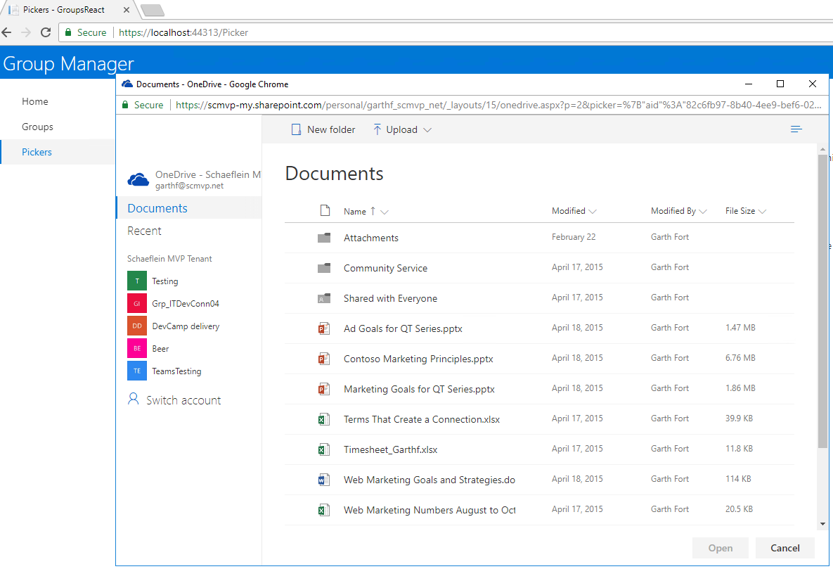
File Picker (OneDrive)
OneDrive file browser experiences
SDK for multiple platforms
Web / JavScript
Android
Universal Windows Platform
OneDrive personal and OneDrive for Business
File Open experience
Set Initial location
Filter file types / Include metadata
Get URL for download or web view
File Save experience
Allows user to select folder
Returns information about file

Slide 4
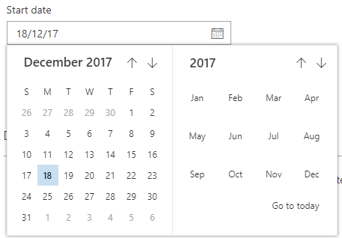
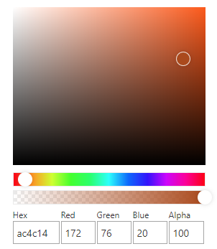
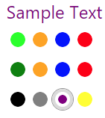
Office UI Fabric Pickers
React components styled like Office 365
People Picker
Multiple styles of selecting and displaying people
Events to customize / filter choices and selections
Date Picker
Select a date, with optional boundaries and formatting
Color / Color Swatch Picker
Choose or enter a color code
Choose from a pre-defined set

Slide 5
Demo File / People Pickers

Slide 6

Interact with Microsoft Graph using Office UI Fabric Cards
Persona / Facepile
Documents / Activity
Hover Card
Demo

Slide 7


Persona / Facepile
Represent users in content
Various sizes with specific purposes
Follow best practices for consistency
Focused on user information
Avatar or Initials
Name / Title / Department
Presence
Often used in Document & Hover cards
Show additional, contextual information in a Hover card

Slide 8
Document Card
Document Card has multiple parts
Use what you need
Preview
PreviewImage
Logo
Title
Location
Activity / ActivityPerson
Actions
Status
Compact layout available
libraryActivity = ( <DocumentCard> <DocumentCardLogo logoIcon='OneDrive’ /> <DocumentCardTitle title='Latest Documents’ /> <DocumentCardPreview previewImages={recentDocs.previewImages} getOverflowDocumentCountText={recentDocs.getText} /> <DocumentCardLocation location='View Library’ locationHref={this.props.group.driveWebUrl} /> </DocumentCard> );

Slide 9
Hover Card
private _onRenderCompactCard = (item: any): JSX.Element => { return ( <div className='hoverCardExample-compactCard’> <a target='_blank’ href={ `http://wikipedia.org/wiki/${item.location}` }> { item.location } </a> </div> ); } private _onRenderExpandedCard = (item: any): JSX.Element => { const { items, columns } = this.state; return ( <div className='hoverCardExample-expandedCard’> { item.description } <DetailsList setKey='expandedCardSet’ items={ items! } columns={ columns } /> </div> ); }
Shows supplemental information in context
Provides compact and expanded sections
Avoid too much information at first
Complete control of experience
Callbacks for open / close / rendering
Properties for spacing / direction / size

Slide 10
Demo Document Card

Slide 11

Interact with Microsoft Graph using Adaptive Cards
Capabilities and Use Cases for Adaptive Cards
Demo

Slide 12
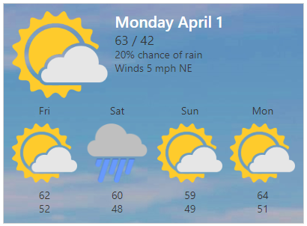
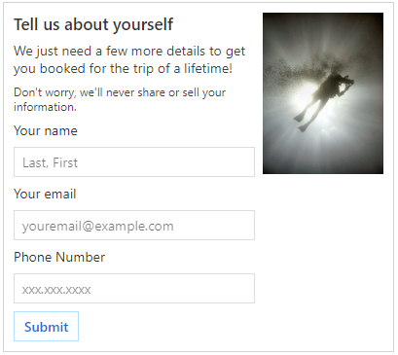





Capabilities of Adaptive Cards
Portable, Expressive Content
A rich palette to express content, across apps, devices and UI frameworks.
Adaptive use of Controls
Content and controls adapt to the host application.
One Schema – Shared Tooling
You get a single format, minimizing the cost of creating a card and maximizing the number of places it can be used.
Declarative, Safe payloads
No code is needed or allowed. Content is delivered in safe payloads so you don't have to open up your UI framework to raw markup and scripting.

Slide 13
Demo Using Adaptive Cards to Interact with Microsoft Graph

Slide 14

Summary

Slide 15
Thank you

